Slide 1
CM Dashboard Arunachal Pradesh
Advisory Services Analytics
Arunachal Pradesh State Council for IT & e-Governance (SCITeG)
16th April 2018
Ernst & Young LLP

Slide 2

Agenda
1
About E&Y?
2
Project Vision
3
Project Objective
4
Proposed Solution

Slide 3


We are the leading global professional services firm
225,000+ people
750 offices
150 countries
1 unwavering commitment
EY is the global leader in assurance, tax, transaction and advisory services. Worldwide, our 200,000 people are united by our shared values and an unwavering commitment to quality.
People who demonstrate integrity, respect and teaming
People with energy, enthusiasm, and the courage to lead
People who build relationships based on doing the right thing
At EY, we’re committed to helping our people, our clients and our wider communities achieve their potential;
It’s how we make a difference.
Who We Are
What We Stand For
%
EY - Europe, the Middle East, India & Africa (EMEIA)
Brings together 93,000 people from 96 countries
Operates through 12 effective Sub-Areas that mirror the operations of many of our key clients
The first of the Big 4 firms to achieve this
EY in India I11,500+ professionals | 10 locations | 310 partners

Slide 4
Global Advisory
Our Advisory services combine global reach with a culture of collaboration
150 countries
*45,000+ professionals
We operate as a single business across all geographical areas. This, facilitates our decision – making and speed of execution.
EMEIA
19,130+
professionals
Japan
1,250+
professionals
Americas
15,360+
professionals
APAC
6,680+
professionals
India Advisory
10 locations | 4,500+ professionals | 96 partners
* Note: The overall advisory headcount numbers also includes the executive headcount numbers (2600+ professionals).

Slide 5

Right Experience
We have significant expertise in providing IT advisory and enablement services to various Government and Public Sector Enterprises across geographies and market sectors.
Urban Infra & Smart Cities, e-Governance
Transport
Power & Utilities
EDA, Defense & Security
Sectors
Agriculture, Rural Development & Livelihood
Skill Development & Education
Health & Identity
Public Finance Management
400+
Strength
Dedicated team of more than 400+ Analytics personnel across Indian cities
Extensive Knowledge across Ministries and State Government
Global Network across 150 countries in the world
Significant experience in system design and development
Globally, EY provides services to over 1000 Government units
Services
Data Quality Management
Analytics Centre of Excellence
Data Federation & Data Exchange Services
Data Warehouse Design & Build
Performance Management
Bhamashah, Government of Rajasthan
Project INSIGHT, Central Board of Direct Taxes, Government of India
Analytics CoE, Government of Rajasthan
EIU, Government of Telangana
Max Life Insurance Analytics
E-Pragati
Single Window & Ease of Doing Business (Uttarakhand, Himachal Pradesh, Jharkhand, Chhattisgarh, Telangana)
Project INSIGHT, Central Board of Direct Taxes
HR/FP&A DWH, Genpact
Supply Chain DWH, Medanta Hospitals
Chief Minister’s Dashboard, Chhattisgarh
Chief Minister's Dashboard, Arunachal Pradesh
ServicePlus Data Analytics, NICSI
Credentials

Slide 6
Project Vision
Catalyst for enhancing the effectiveness of Govt processes
Achieve a high rank in global e-Governance Development/District Index
Developmental
Aspirational
Technological
Citizen-Centric
Standardization, Technological excellence In-sync with global trends and technological advances
Reduction of the need for repeated provision of the same data to multiple departments within the same government; ease of single-window service provision
Inclusive
Uniformity of information availability across all population and demographic segments

Slide 7
Project Objectives
Government Perspective
Department Perspective
Good and effective governance to roll out better services and attract investment in the state
Improve fiscal health of the state machinery by eliminating waste and bringing in efficiency
Aids in performance monitoring of key initiatives of the state and central
Provides enhancement of performance based culture
Data-driven and Analytical approach for decision-making
Departmental Ownership – to establish and deliver on a strategy across multiple departments, the departments must realize the need for and drive the KPI agenda. In addition, it is essential to gain operational level acceptance and support for the proposed changes, through early engagement and ownership in the process
Government
Departments
Project Objectives
Data Standardization & Interoperability
Outcomes
1
2
3
4
5
Single Source and Points of Truth for Data Elements
Centralization of Critical and Master Data Elements
Increased confidence on data by adequate data quality
Multi-channel and secured data propagation
Departments having adequate control on data access and usage

Slide 8
Identified Departments for CM Dashboard
Economics & Statistics
Finance
Planning
CM Dashboard
Education
Power
PHE & WS
RD
Agriculture
Health

Slide 9

Proposed
Solution
We would provide solution through various frameworks of Agile methodlogy

Slide 10
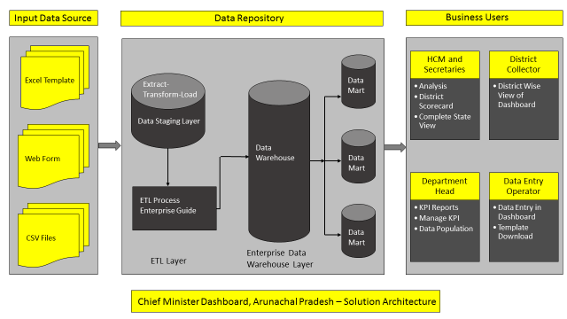
Solution Architecture & Design

Slide 11
Thank You
Ernst & Young LLP

